Slide 1
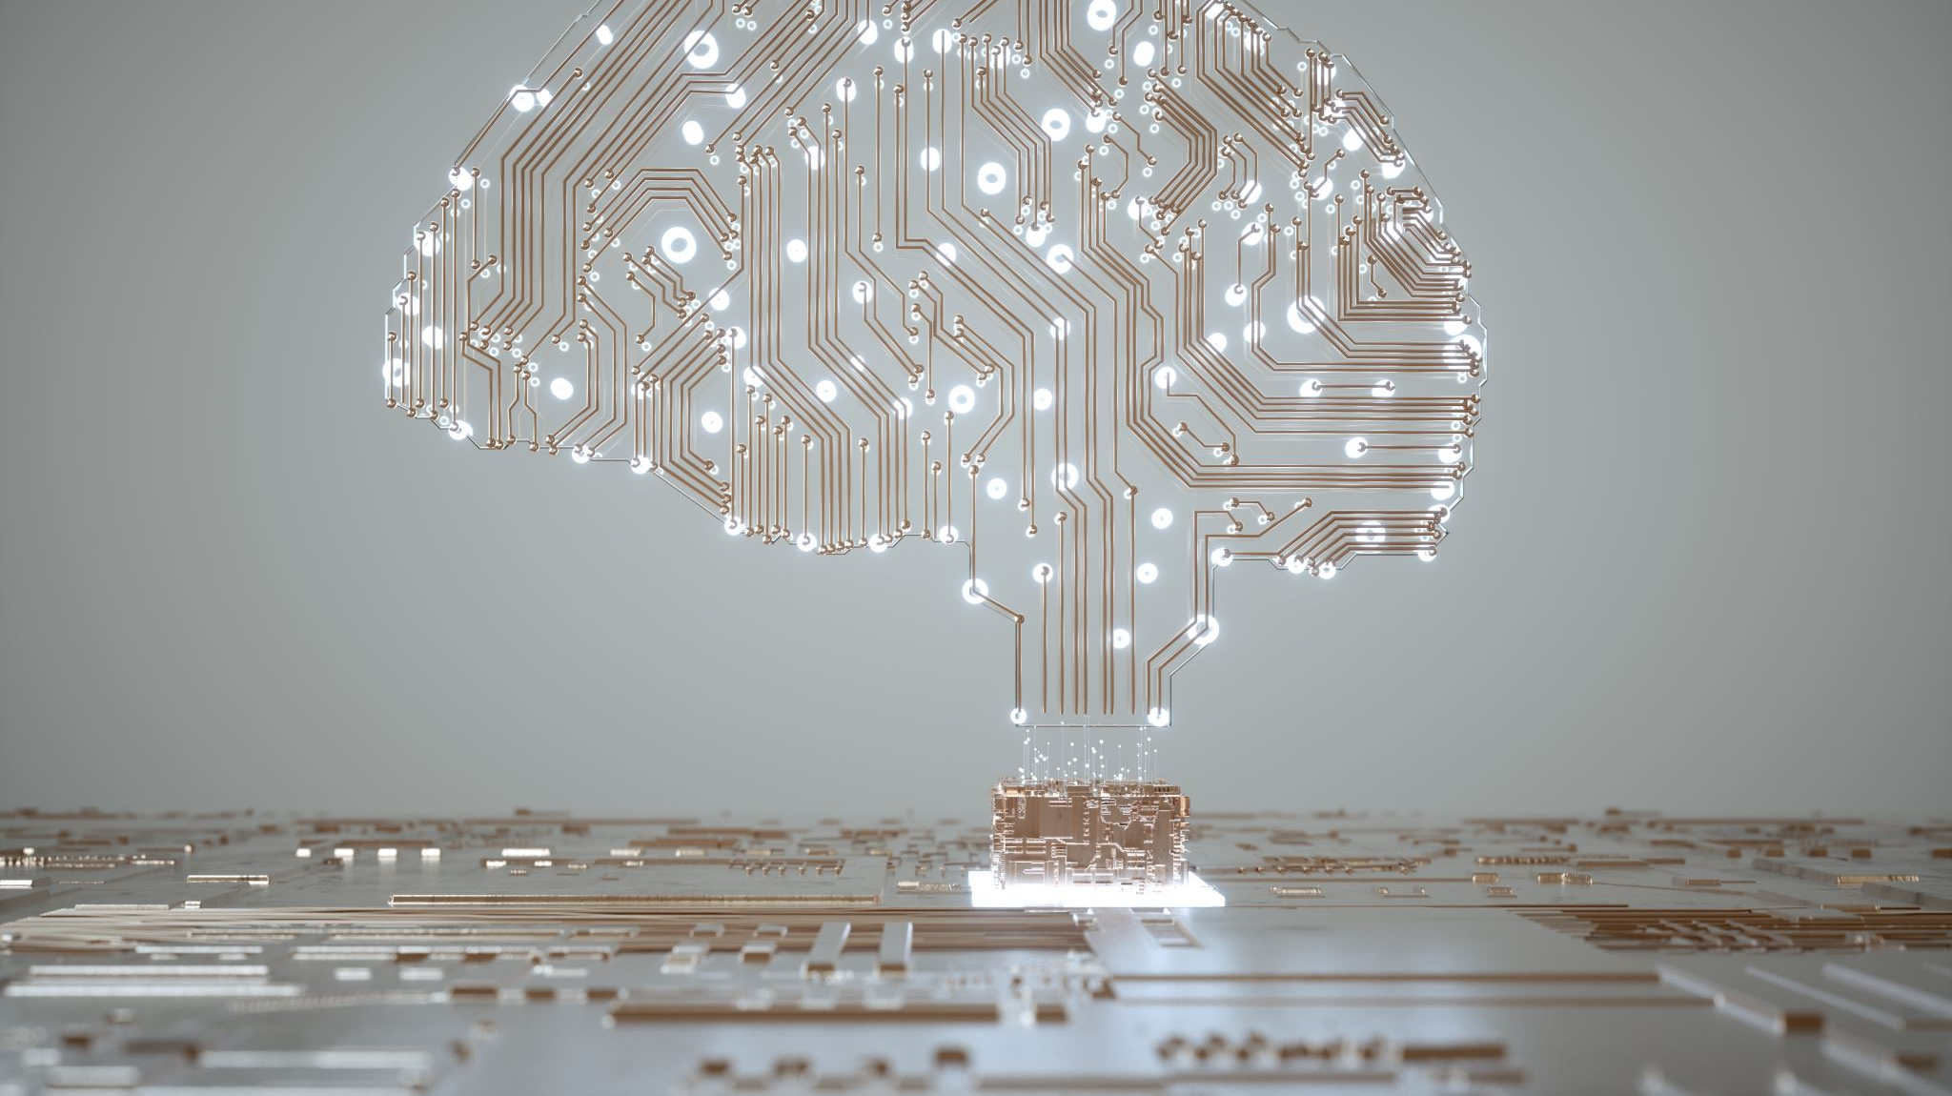
Artificial Inteligence in Education
Dragea Larisa Maria
Group 923
Computer Science in English

Slide 2
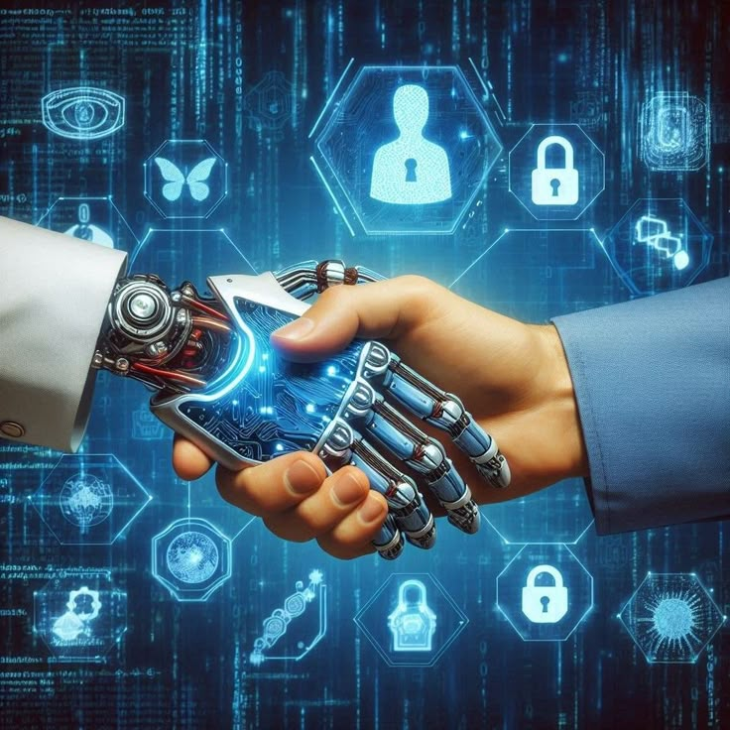
What is AI?
Artificial Intelligence (AI) refers to the ability of computers or machines to perform tasks that normally require human intelligence. These tasks include learning from data, solving problems, recognizing patterns, and understanding language.
In education, AI has become a powerful tool capable of analyzing information quickly, adapting to individual student needs, and supporting teachers in their daily activities. It improves both teaching and learning by offering solutions that were not possible with traditional methods.

Slide 3

Why AI Is Useful in Education?

Slide 4

AI Helping Teachers
AI is extremely helpful for teachers because it takes over many repetitive tasks that normally require hours of work. Teachers often spend a lot of time correcting assignments, preparing materials, and organizing schedules, but AI tools can automate processes such as grading quizzes, sorting homework, and tracking attendance.
This gives teachers more time to focus on what truly matters—teaching, guiding, and supporting their students.

Slide 5
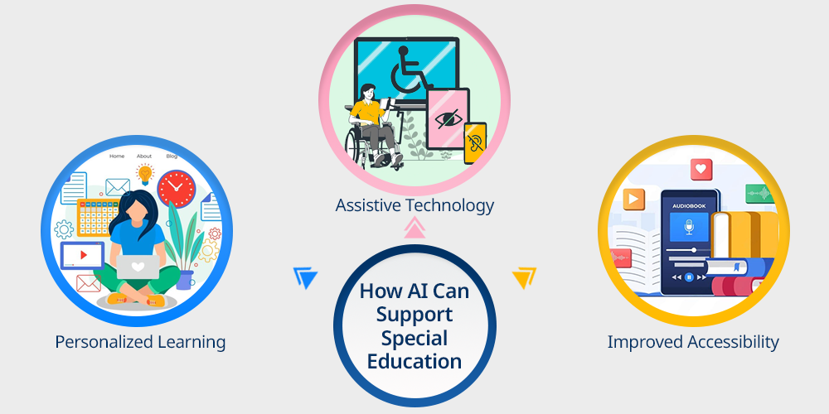
AI and Accessibility
AI makes education more accessible for students with learning difficulties or disabilities:
adapts learning materials to individual needs.
offers alternative ways to access information.
provides personalized support.
speech-to-text helps students who struggle with writing.
text-to-speech supports students with dyslexia or visual impairments.

Slide 6
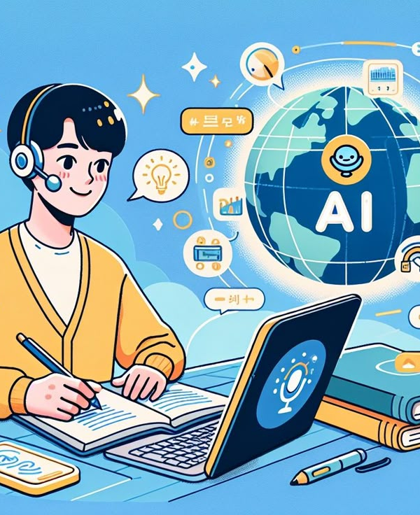
AI in Language Learning
AI has significantly changed the way students learn new languages by making the process more personalized, flexible, and interactive.
Through advanced algorithms, AI can understand how each learner progresses, identify difficulties, and adapt language lessons to individual needs. This creates a learning experience that feels more natural.
With AI, students can practice whenever they want and receive immediate guidance, which helps them build confidence and improve their communication skills more effectively than traditional methods alone.

Slide 7
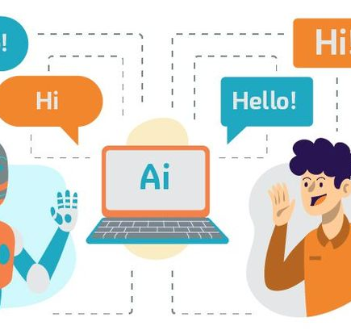


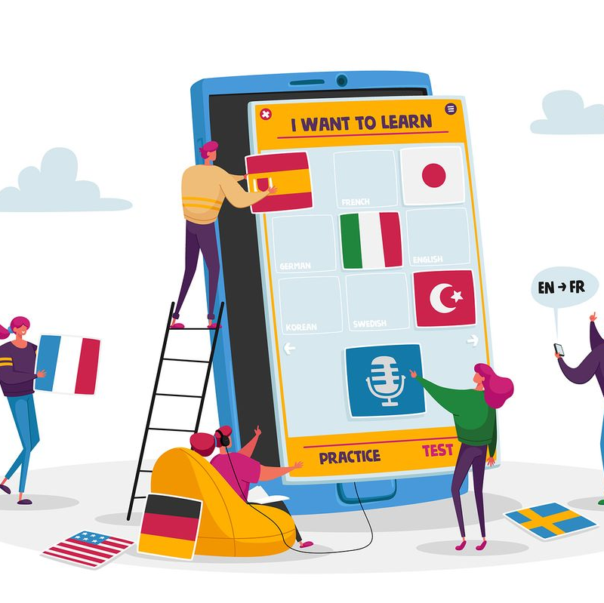
Additional Examples in Language Learning
There are several AI-powered tools that make language learning more effective.
Apps like Babbel, Memrise, and Grammarly help students expand vocabulary, correct grammar, and strengthen writing skills.
Duolingo uses AI to provide instant pronunciation feedback and adapt lessons to student performance.
Chatbots simulate real conversations with native speakers, offering a safe space to practice speaking.

Slide 8

AI and Digital Safety
AI improves digital safety in schools by monitoring online activity and identifying potential risks during digital lessons.
AI tools also block dangerous websites, filter offensive messages, and recognize patterns related to cyberbullying.
By analyzing chat activity and ensuring respectful communication, AI helps create a safer online environment where students can focus on learning without being exposed to digital threats.

Slide 9
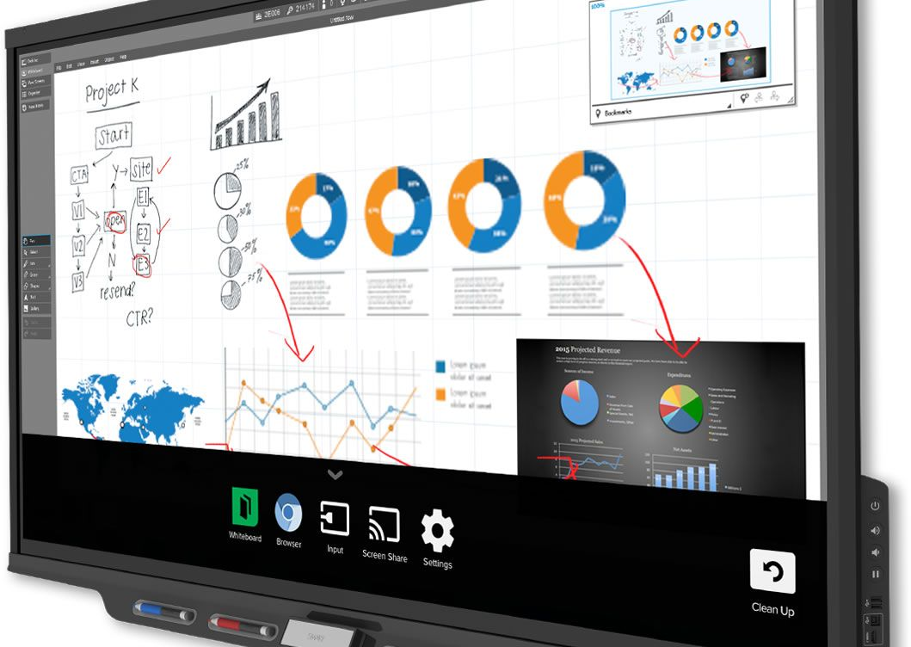
Smart Classroom Tools
In many schools, smart classroom tools make lessons more organized and interactive.
Digital boards, classroom platforms, and simple AI features help teachers present content clearly, share materials, and offer students extra practice when needed.
These tools save time and keep students more engaged.

Slide 10

Challenges and Disadvantages of AI in Schools
Although AI offers many benefits, it also brings several challenges and disadvantages when used in schools. These issues need to be understood so that technology can be used responsibly and effectively.

Slide 11
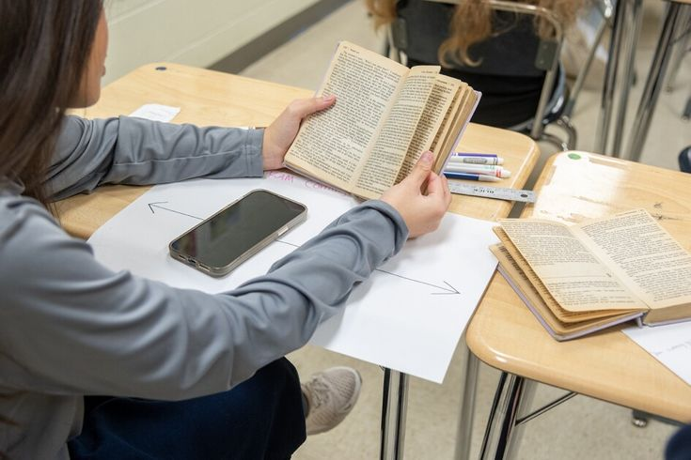
Risk of Overdependence
One disadvantage is that students may rely too much on AI tools and stop thinking for themselves. If learners always depend on AI to check grammar, solve problems, or generate ideas, they may develop weaker critical thinking and problem-solving skills.
It is important for students to use AI as support, not as a replacement for learning.

Slide 12

Unequal Access to Technology
Not all students have access to laptops, tablets, or fast internet. This creates inequality because some students can benefit from AI tools while others cannot.
Schools must find ways to make technology available to everyone so that learning remains fair.

Slide 13
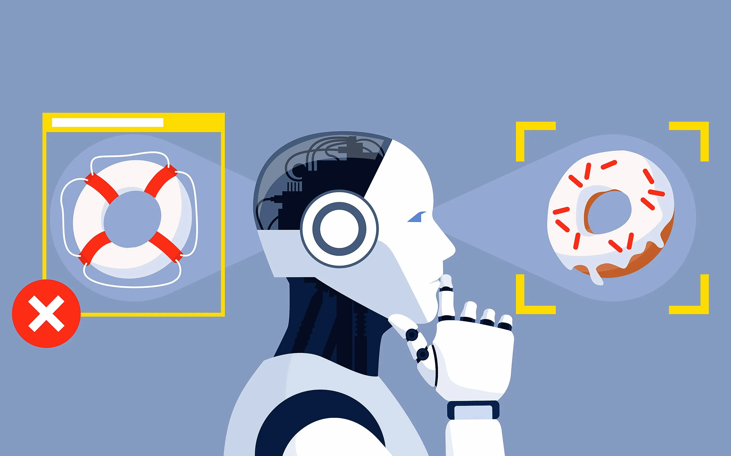
AI Can Make Mistakes
AI doesn’t always understand what students mean.
It can give incorrect answers or unsuitable suggestions, so it’s important to check information from multiple sources.

Slide 14
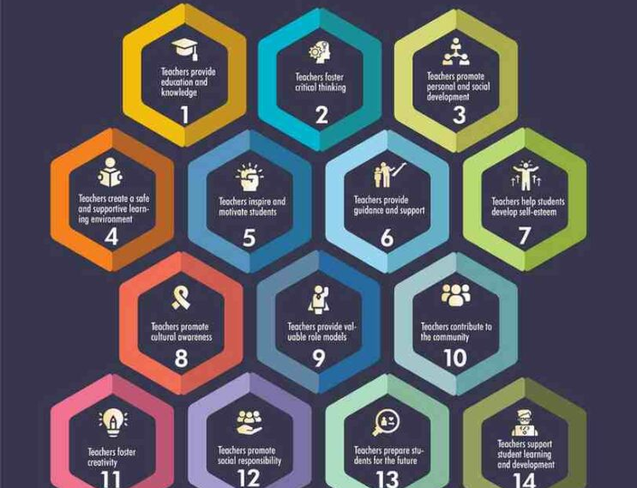
The Role of Teachers Is Still Essential
Even with the growing use of AI, teachers remain irreplaceable.
AI cannot understand emotions the way people do, cannot motivate or inspire students, and cannot replace human connection.
It is most effective when used alongside teachers to improve learning—not instead of them.

Slide 15
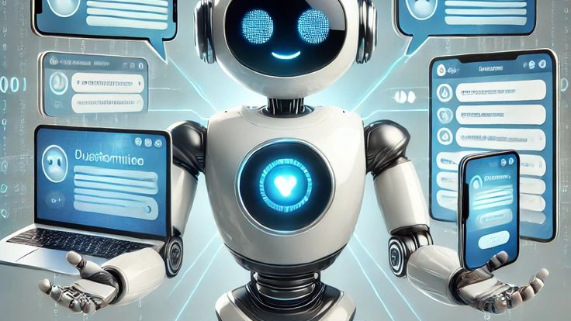
Thank You

